Slide 1
How the Pentagon Funds University Research
By
Subrata Ghoshroy
Program in Science, Technology, and Society
MIT
Presented at
The Seminar on “Science at MIT”
28 April 2015

Slide 2
The Context: Why do we need to talk about research on campus?
The resources are finite for even the most powerful and the wealthiest of nations
Why should so much money be spent on the military when many urgent priorities need to be addressed?
Redirection of scientific research away from military to societal needs is urgently needed
There are not only moral and ethical issues, but it also makes economic sense

Slide 3
Agenda
A brief historical overview U.S. Government’s role in science and technology
The Cold War paradigm
Pentagon-supported research at MIT
The character of defense R&D
Urgent challenges and misplaced priorities

Slide 4
The U.S. Government in Science and Technology
The Manhattan Project to develop the atomic bomb
  Marshaling science for war
Cold-War strategy based on massive spending on science and technology
  Maintain an edge over the Soviet Union
  Grow the economy
Military R&D spurred innovation
Public assumed all the risks in funding cutting-edge research and private companies reaped huge profits
  Electronics, computers, biotechnology, and military systems including aircraft, ships, missiles, navigation

Slide 5
Cold War priorities continue a quarter century after the fall of the Soviet Union
Massive defense spending continues
  Nearly $600 billion
  It is higher than it was at the peak of the Cold War when adjusted for inflation
Defense R&D spending continues to grow
  Higher than the civilian R&D
  Nearly $70 billion in defense R&D
  Much of what is spent in defense R&D produces no “science” and little or no new technology

Slide 7
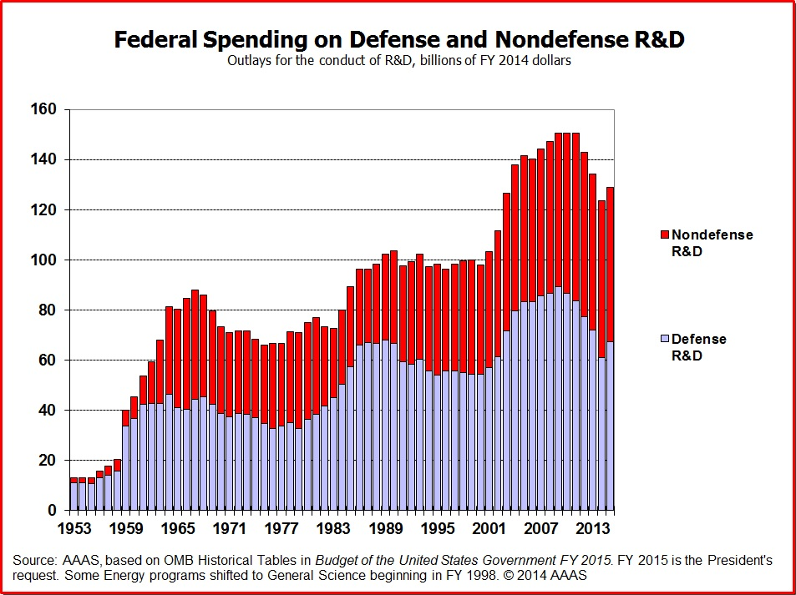

Slide 8
The Pentagon and the Universities: militarization of science and technology
The Pentagon supports most academic research in physical sciences and engineering
  About $2 billion a year
The following are noteworthy:
  Electrical Engineering 72%
  Mechanical Engineering 75%
  Metallurgy and Materials Science 35%
  Math and Computer Science 30%
  Source: DoD Basic Research Plan, February 2005, p.IV-3
  See “the Pentagon and the Universities” a fact sheet: http://demilitarize.org/fact-sheets/enfact-sheet-pentagon-universities/

Slide 9
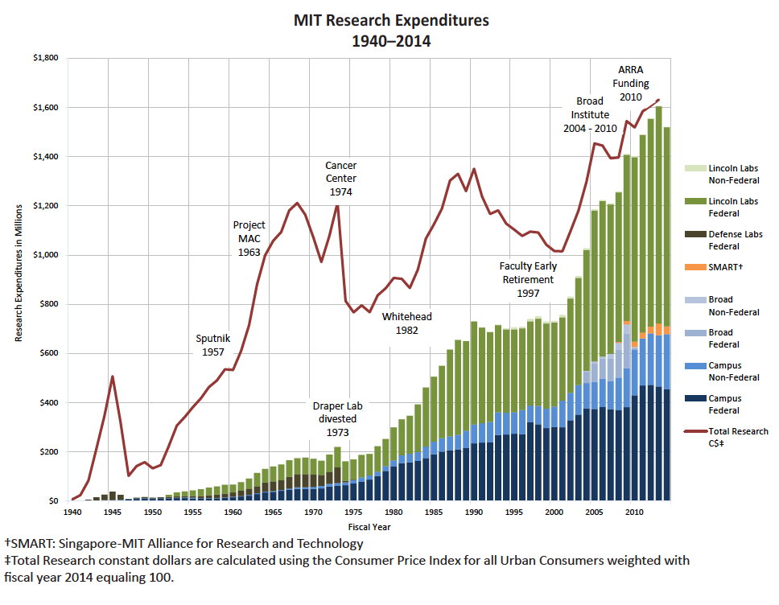
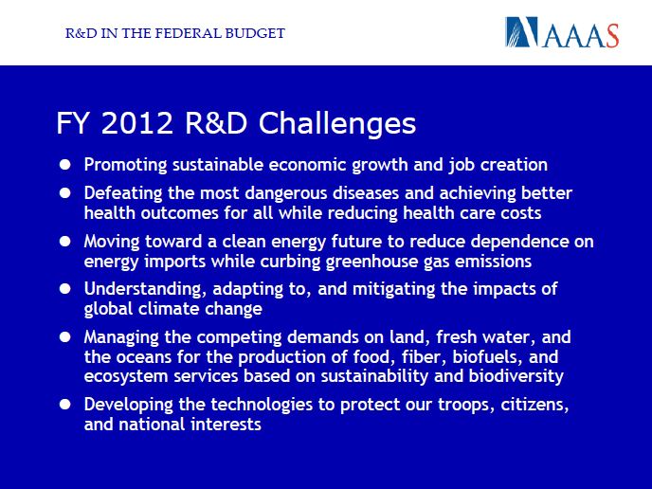
Obama’s Rhetoric

Slide 10
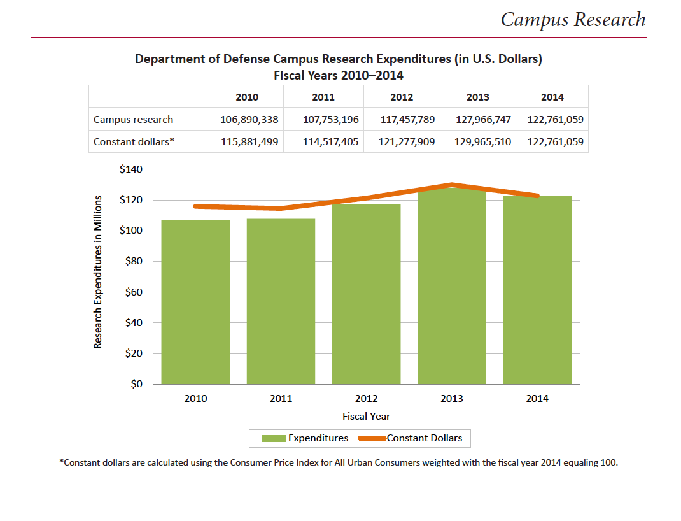

Slide 11
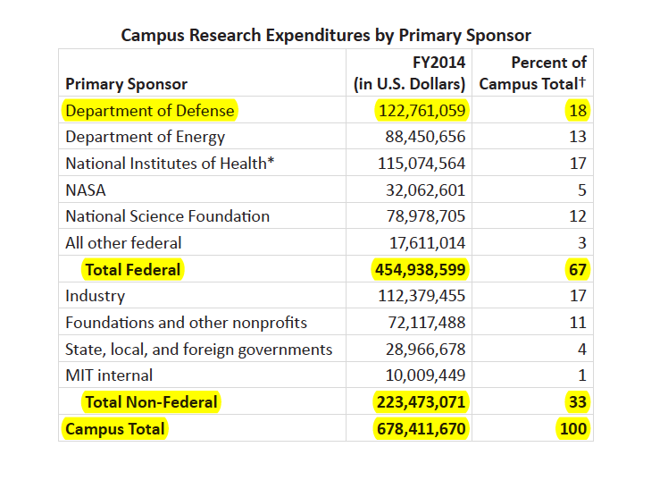
MIT

Slide 12
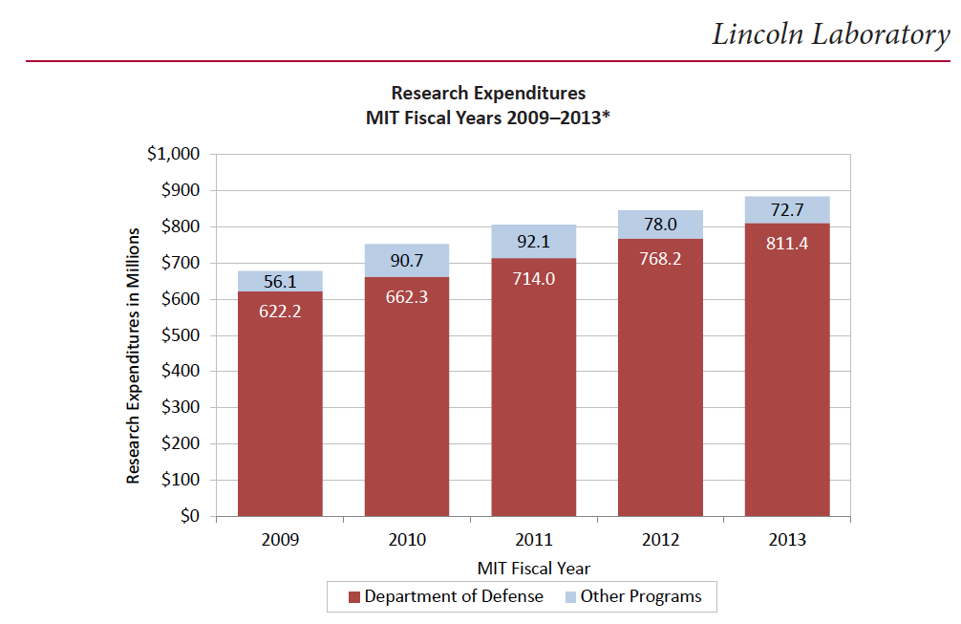

Slide 13
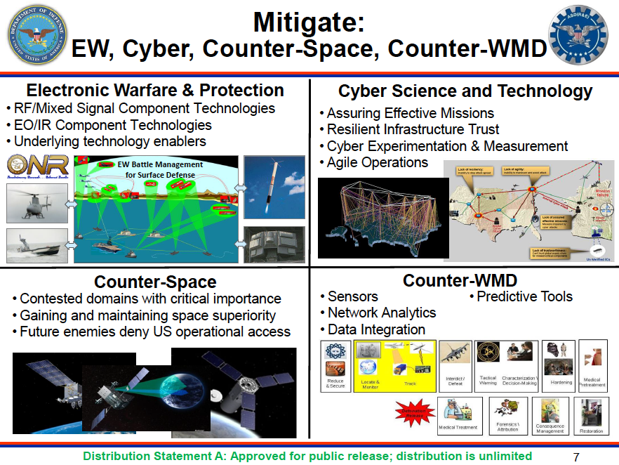

Slide 14
Current MIT Research funded by the Pentagon
MIT is among the top 10 recipients of the Pentagon funds
Top research areas:
  Autonomous systems
  Artificial intelligence
  Nano technology
  Cyber security
  Sensors
  Intelligence, surveillance, and reconnaissance
  Missile defense

Slide 15
Misplaced Priorities cannot be sustained
Need of the hour
  Green technologies
    Fuel efficient cars
    Electric vehicles
    High speed rail
    Solar energy
    Clean coal
  Manufacturing technologies
Spending priorities
  Missile defense
  War against terror
  IED’s
  MPC&A
  Bio-defense
  Stealth fighter
  Nuclear weapons

Slide 16
Contrast in spending:
A bad omen for the future
Clean Energy and Climate Science: $2 billion | Missile Defense: $10 billion
Combined Science Budget for NSF, DOE, and NIST: 14 billion | Nuclear Weapons: $50 billion
Education: $140 billion | Military R&D and Weapons procurement: $190 billion
Source: various

Slide 17
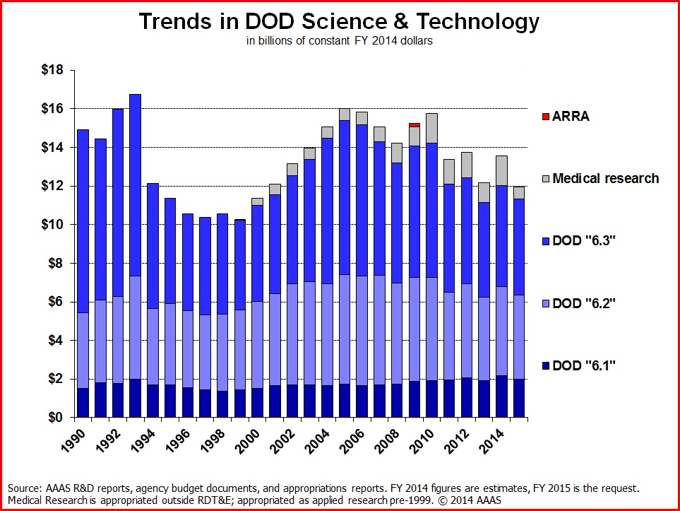

Slide 18
Degradation in the quality of science
Military-funded research of high quality drove innovation and discovery in physical sciences
  Quality of research was consistently high throughout the 50’s, 60’s and part of the 70’s
The model was science-focused small projects
Starting in late 70’s a gradual change to bigger projects with less science and more systems focus
Acceleration of this trend during the Star Wars in the mid-80’s and continued thereafter

Slide 19
Peer review missing
Most defense programs lack independent peer review
Classification often unjustifiable keeps information bottled up
Most defense department program officials totally depend on contractors for information
Program officials and contractors have one goal – keep the program funded!

Slide 20
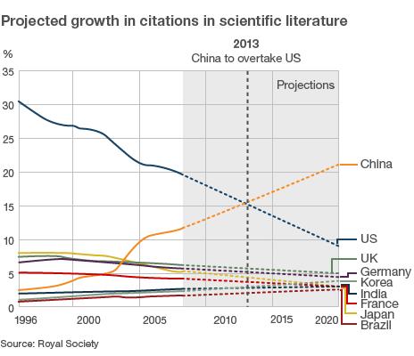

Slide 21
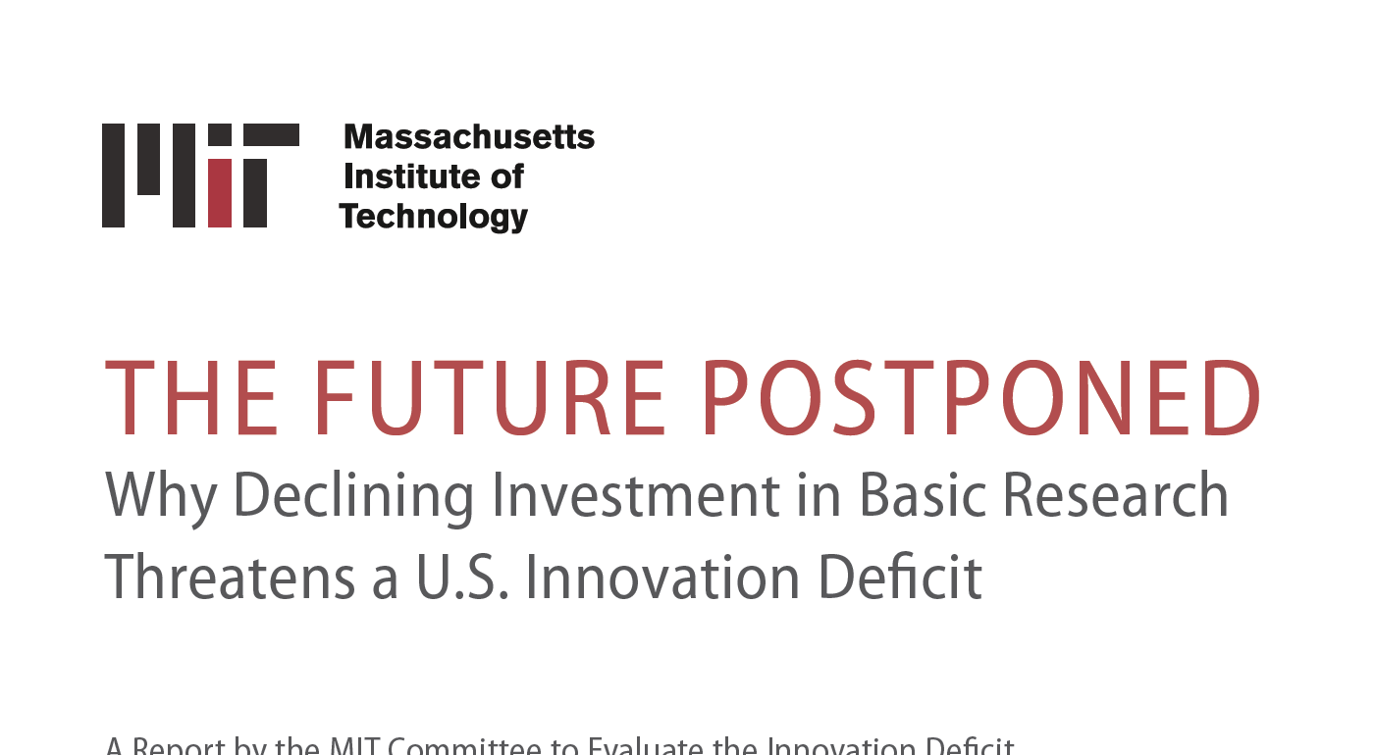
Not enough to ask for more money, must show where it can be found

Slide 22
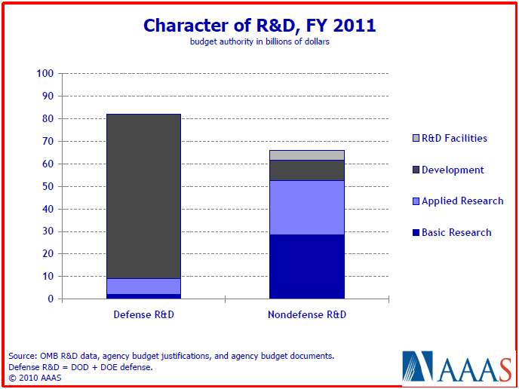

Slide 23
Defense R&D is hugely wasteful
A slush fund for military contractors
Full of boondoggles and outright fraud
  An extreme example is the missile defense program
  As a whistleblower I can speak from my own experience
Needs substantive restructuring

Slide 24
Challenges, but also Opportunities in Redirecting Research Priorities
Challenges
  Research funds are scarce
  University professors depend on them
  Politicians face pressure from their constituents and contractors about jobs
  It is convenient to support funding “R&D”, especially for defense
Opportunities
  Strong public support to cut defense budget
  A restructuring of spending priorities to improve quality of science and foster innovation would appeal to university researchers
  Diverting military “R&D” funds to civilian R&D would preserve jobs

Slide 25
Opposition to military research at MIT during the Vietnam war
1969
  Protest against two MIT “special laboratories”
    The Instrumentation Lab and Lincoln Lab
    Classified research on campus
  Takeover of the Student Center
  MIT shut down for one day to discuss the problems of science, technology, and society
  MIT President appoints a panel to review its relationship with the two labs
    Prof. William Pounds, Chair
1973
  The Instrumentation Lab, which designed guidance control systems for Trident nuclear missile separated from MIT
Notes:
Both Lincoln Lab and the Instrumentation Lab does work that is directly related to the military mission. Lincoln Lab continues to be a part of the MIT. It gets significant amount of money to operate the lab.

Slide 26
Ad Hoc committee appointed in 1986 to study “Military Impact on Campus Research”
In response to student and faculty protests about MIT participation in Reagan’s Star Wars program
Functioned from 1986-1992 (Prof. Herman Feshbach, Chair)
Found strong dependence of certain areas of research on DOD support
Expressed concern about all sponsored research and particularly DOD support
Concurred with the Pounds Commission.
Recommended that there should be broad oversight and openness in research

Slide 27
Some Concluding Thoughts
The U.S. still leads the world in R&D and it continues to attract the best and the brightest
A strong work ethic and drive for innovation still thrive
Cold War priorities in U.S. foreign policy, defense, and science funding not sustainable
Scientists can play a crucial role in bringing about the needed change in priorities
We must engage in social and political issues more effectively

